Slide 1
Best coding conventions

Slide 2
Best Practices in Coding
Some basic issues in every development team
fundamental discipline issues in coding
number of years of exp. does not match delivery
by the time they actually become good coders, they are promoted to leads
70% of the whole employees, belong 0-4 years of experience
Coding is not rocket science
The rework time in coding is the actual killer
20-25% of the time is spent in reworking in software – that means, fix the mistakes done

Slide 3
Coding Practices - Introduction
In a mobile phone, can you insert sim card wrongly? You cannot. Because the sim card design is like that. So the highest level maturity is not to give an opportunity to make mistakes
As a kid, you were asked and helped to brush the teeth. It was tough to brush teeth.
One fine morning, you start brushing teeth by yourselves.
Then it has become a habit. You need not be told to do brushing by anyone.

Slide 4
Coding best practices are a set of informal rules that the software development community has learned over time which can help improve the quality of software
Software programmers are highly recommended to follow these guidelines to help improve the readability of their source code and make software maintenance easier.

Slide 5
Reducing the cost of software maintenance is the most often cited reason for following coding conventions. In their introduction to code conventions for the Java programming language, Sun Microsystems provides the following rationale
40%–80% of the lifetime cost of a piece of software goes to maintenance.
Hardly any software is maintained for its whole life by the original author.
Code conventions improve the readability of the software, allowing engineers to understand new code more quickly and thoroughly.
If you ship your source code as a product, you need to make sure it is as well packaged and clean as any other product you create.

Slide 6
Commenting
In computer programming, a comment is a programmer-readable explanation or annotation in the source code of a computer program. They are added with the purpose of making the source code easier for humans to understand, and are generally ignored by compilers and interpreters.
Comments can be used to summarize code or to explain the programmer's intent.
According to this school of thought, restating the code in plain English is considered superfluous; the need to re-explain code may be a sign that it is too complex and should be rewritten, or that the naming is bad.

Slide 7
In the early days of computing, one commenting practice was to leave a brief description of the following:
Name of the module
Purpose of the Module
Description of the Module
Original Author
Modifications
Authors who modified code with a description on why it was modified.
The "description of the module" should be as brief as possible but without sacrificing clarity and comprehensiveness.

Slide 8
Commenting is necessary for maintaining any program
Without commenting, the program is not complete
Do not assume that the other person who reads this program will understand it clearly
If commenting is not done at the beginning, it is forgotten.
Program - a physical file – you need to comment the following at the top.
at the top of the program - header comment
what the program achieves
who coded on what day
Classes
Comment at the beginning of the class about what the class does
class Employee
// this class is used to manage all information
// about employees and retrieve specific data
Methods within classes
what this method/function/procedure does
what are the parameters and their purpose
what are the return values
Comment before every loop.
Comment before every file or database operation
Comment before every if condition

Slide 9
Commenting
If you are team leader, if your team member comes with a code, that does not have these comments – what will you do?
You take over a program for maintenance from another person, and that program has no comments – what will you do?
Your company hands over a project to client. Programs do not have comments. What the client will say?

Slide 10
Comments can help maintain consistency. If you have consistent, well-written comments for what you are building then you are more likely to build things the same way each time.
Comments facilitate understanding. This is really important in a team where sometimes one person does not do all the work.
Comments help speed up the development process. You can have a clearer understanding of what you are creating, changing or removing if you include relevant comments.
Comments facilitate more efficient collaboration. If you know the ins and outs of a project or codebase, you are more likely to get bits and pieces done quicker, thus improving workflows.

Slide 11
It’s good to read over any comments you write to ensure that you understand them yourself. Imagine you are someone new to the code and you are reading the comments as a guide.
There are no hard and fast rules about how to format comments in your code. The number of lines, words, or what information to include is up to you, or can be decided between you and your peers. As long as you keep the format consistent, it will keep things tidy and encourage other people working with the code to do the same.

Slide 12
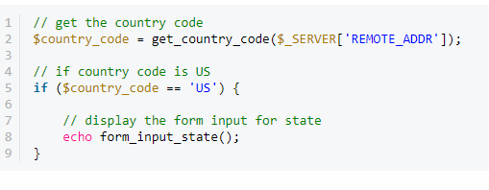
Things to Avoid
Avoid Commenting Absolutely Everything
Do Not Be Too Verbose- you shouldn’t be writing novels – long comments are as much a pain to read as they can be to write.
when naming CSS classes, the following advice is given: Make class names as short as possible but as long as necessary.
Do Not Spend Too Much Time Writing Comments If you are spending too much time trying to comment your code to make sure someone else will understand it, consider that parts of your code might actually need refactoring.

Slide 13
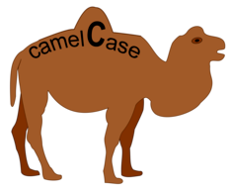
Naming conventions
Camel case is the practice of writing phrases such that each word or abbreviation in the middle of the phrase begins with a capital letter, with no intervening spaces or punctuation. Common examples include "iPhone" and "eBay“
underscores: Underscores between words, like: mysql_real_escape_string().

Slide 14
If an existing project follows a certain convention, you should go with that. Also, some language platforms tend to use a certain naming scheme. For instance, in Java, most code uses camelCase names, while in PHP, the majority of uses underscores.
These can also be mixed. Some developers prefer to use underscores for procedural functions, and class names, but use camelCase for class method names:
So again, there is no obvious "best" style. Just being consistent.

Slide 15
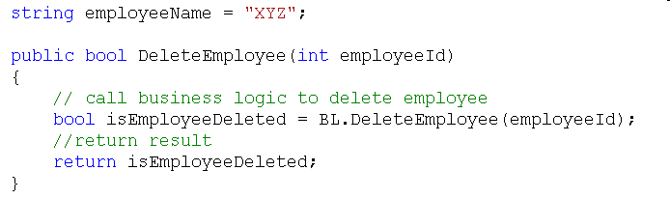
Use camel casing for local variable names, and method parameters.
Notes:
This Capitalization Styles has been suggested by Microsoft for more information have a look at : http://msdn.microsoft.com/en-us/library/x2dbyw72(VS.71).aspx

Slide 16

Do not use single character variable names, such as i , j, k etc. instead of that use Index or Counter for example:
for (int counter = 0; counter < count; counter ++)
{
……..
}
Methods with return values should have a describing name the value it returns. E.g. GetEmployee().
Suffix custom exception classes with Exception.
Suffix custom attribute classes with Attribute.

Slide 17
Keep the code simple
For example, consider these equivalent lines of C code:
if (hours < 24 && minutes < 60 && seconds < 60)
{
return true;
}
else
{
return false;
}
and
if (hours < 24 && minutes < 60 && seconds < 60)
return true;
else
return false;
and
return hours < 24 && minutes < 60 && seconds < 60;
The code that a programmer writes should be simple.
Complicated logic for achieving a simple thing should be kept to a minimum since the code might be modified by another programmer in the future.
The logic one programmer implemented may not make perfect sense to another. So, always keep the code as simple as possible

Slide 18
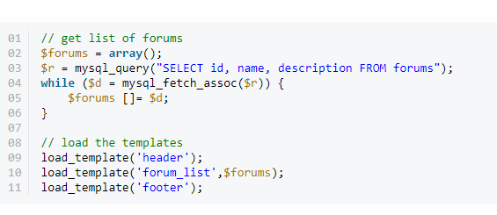
Code Grouping
More often than not, certain tasks require a few lines of code. It is a good idea to keep these tasks within separate blocks of code, with some spaces between them.

Slide 19
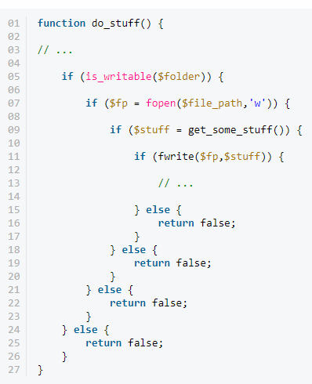
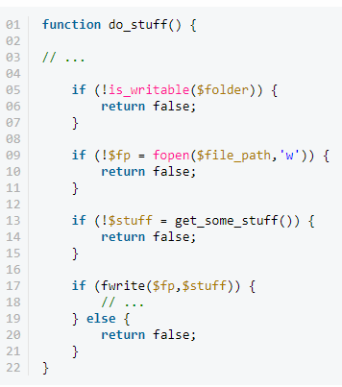
Avoid Deep Nesting Too many levels of nesting can make code harder to read and follow.

Slide 20
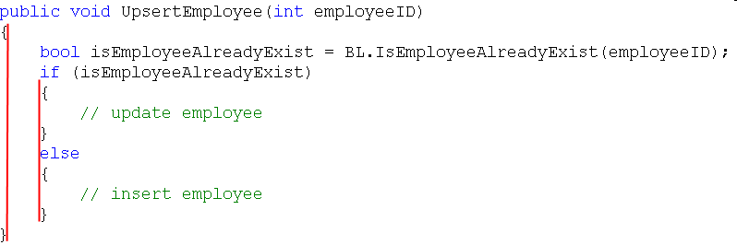
Indentation, spacing and comments
Curly braces should be at the same level.
Use one blank line to separate logical groups of code.
There should be one and only one single blank line between each method inside the class.

Slide 21




Indentation, spacing and comments – Contd..
Use TAB for Spaces and Do not use SPACES. Define the Tab Size as 4 (Tools | Options | Text Editor | <language> | Tabs)
Comments should be in the same level as the code (use the same level of indentation).

Slide 22
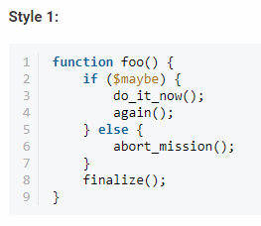
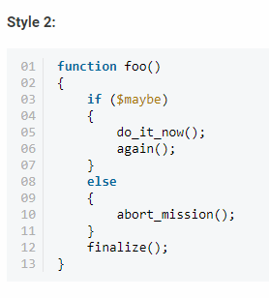
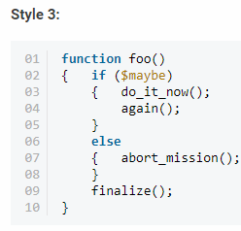
Consistent Indentation

Slide 23
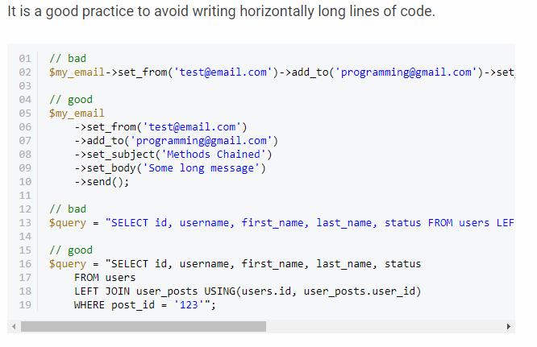
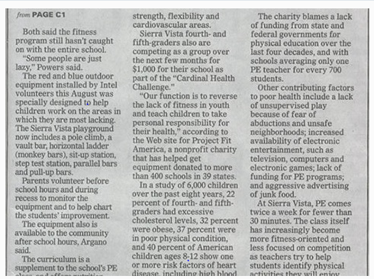
Limit Line Length
Our eyes are more comfortable when reading tall and narrow columns of text. This is precisely the reason why newspaper articles look like this:

Slide 24
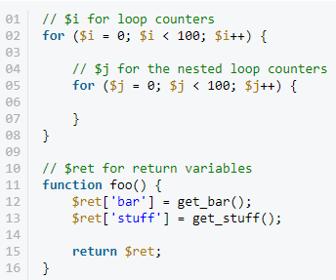
Consistent Temporary Names
Normally, the variables should be descriptive and contain one or more words. But, this doesn't necessarily apply to temporary variables. They can be as short as a single character.
It is a good practice to use consistent names for your temporary variables that have the same kind of role. Here are a few examples that I tend use in my code:

Slide 25
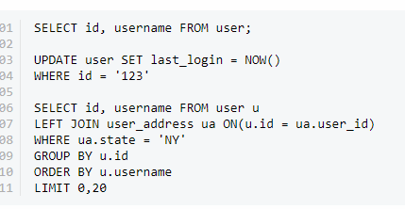
Capitalize SQL Special Words
Database interaction is a big part of most web applications. If you are writing raw SQL queries, it is a good idea to keep them readable as well.
Even though SQL special words and function names are case insensitive, it is common practice to capitalize them to distinguish them from your table and column names.

Slide 26
Separation of Code and Data
HTML
CSS
JS FILE

Slide 27
Code Refactoring
When you "refactor," you make changes to the code without changing any of its functionality. You can think of it like a "clean up," for the sake of improving readability and quality.
This doesn't include bug fixes or the addition of any new functionality.
You might refactor code that you have written the day before, while it's still fresh in your head, so that it is more readable and reusable when you may potentially look at it two months from now. As the motto says: "refactor early, refactor often."
You may apply any of the "best practices" of code readability during the refactoring process.

Slide 28
Q and A
?
The important thing is not to stop questioning. - Albert Einstein

